Slide 1
Logic Gates and Circuits

Slide 2
logic circuits are built up using logic gates.
There are several types of logic gates
Combination and arrangement of these gates makes up a circuit
A circuit basically performs a mathematical task
A circuit can be considered to be a machine that contains many input gates and one output

Slide 3
Types of Gates
OR
AND
NOT

Slide 4
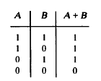
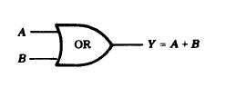
OR Gate, It has two inputs A and B Output Y = A + B

Slide 5
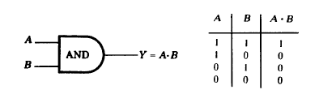
AND Gate

Slide 6

NOT Gate

Slide 7
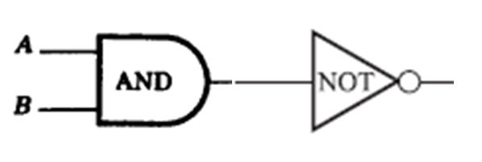
NAND Gate – Not AND
A AND Gate followed by a invertor

Slide 8
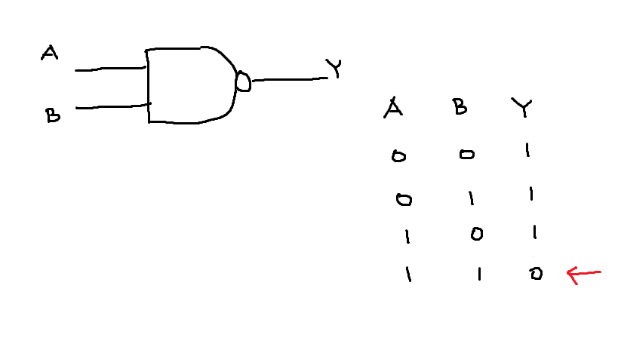
Combined together and Truth Table

Slide 9
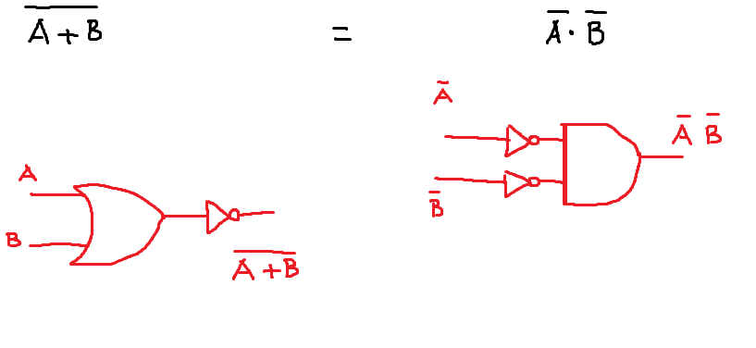
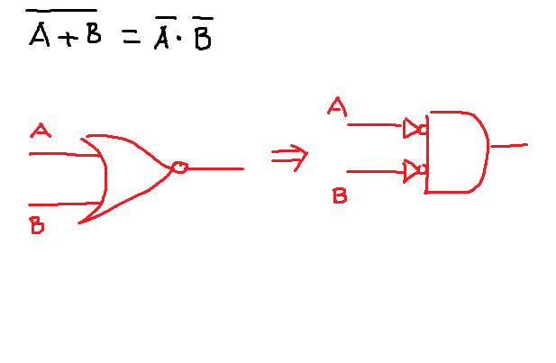
De Morgan's law

Slide 10
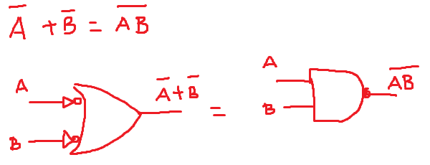
De Morgan's law

Slide 11
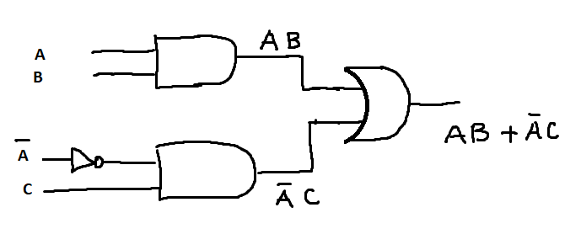
Problem : Convert a Boolean Expression into Logic gates
AB + ĀC

Slide 12
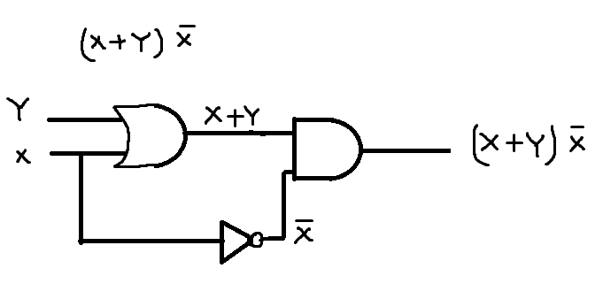
Another example: Boolean Expression to Logic Gates

Slide 13
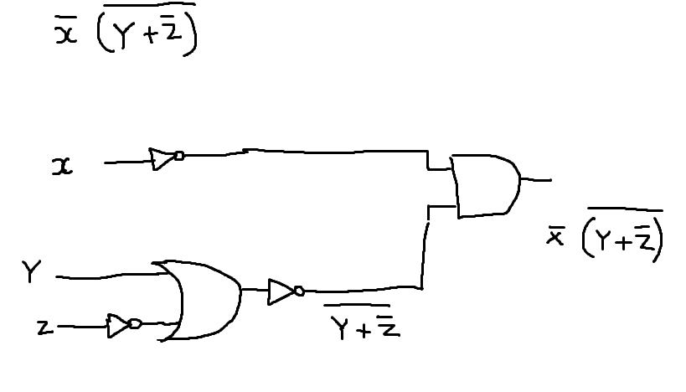
Another example: Boolean Expression to Logic Gates

Slide 14
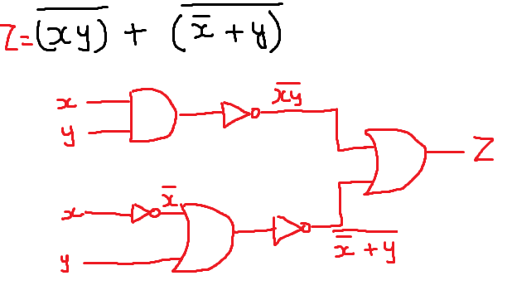
Another example: Boolean Expression to Logic Gates

Slide 15
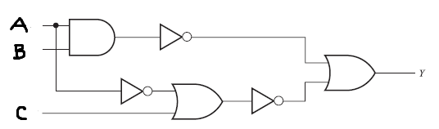
Convert Logic Gates to Boolean Expression

Slide 16
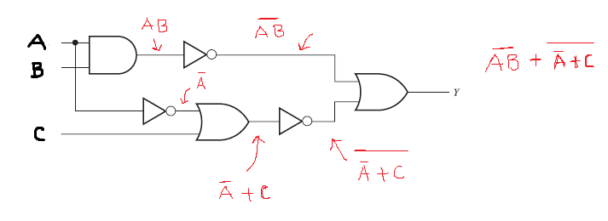
solution

Slide 17
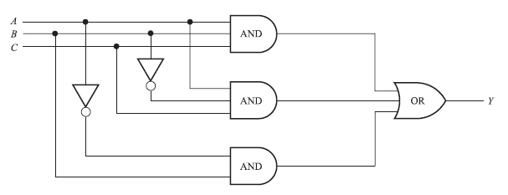
Logic to Boolean expression

Slide 18
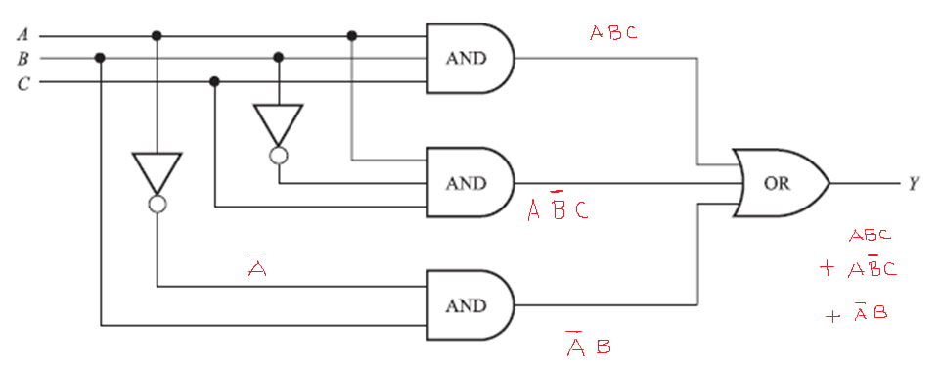
Solution

Slide 19
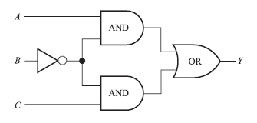
Logic Gates to Boolean Expression

Slide 20
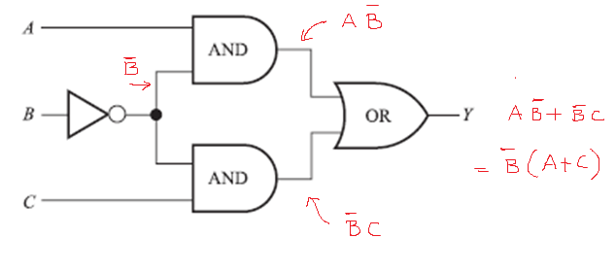
solution

Slide 21
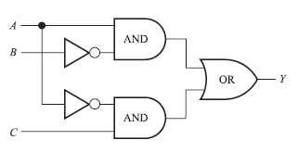
Problem

Slide 22
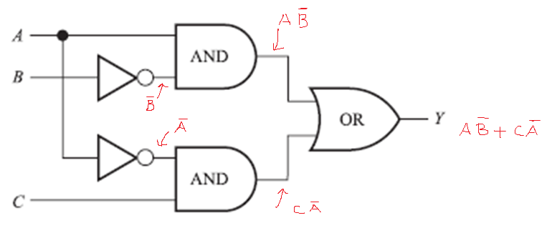
Solution

Slide 23
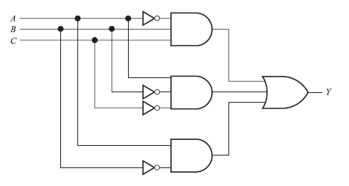
Problem – Do this in Class

Slide 24
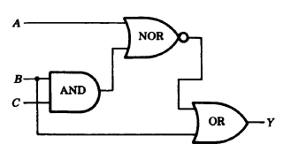
Problem – Do this in Class

Slide 25
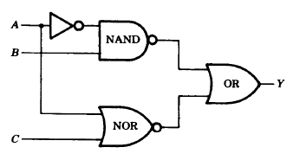
Problem – Do this in Class

Slide 26
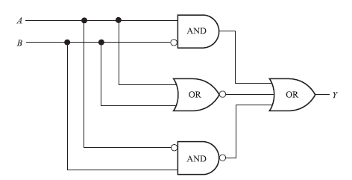
Problem

Slide 27
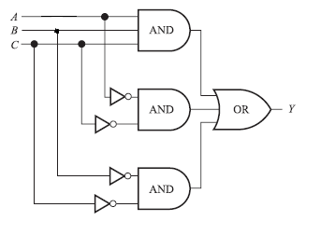
Problem

Slide 28
